Slide 1
How to talk to millions of IoT devices without pulling out your hair!
Harold Pulcher
pulcher@pulcher.biz
https://github.com/pulcher/AzurePlay

Slide 2

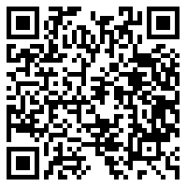

Slide 3
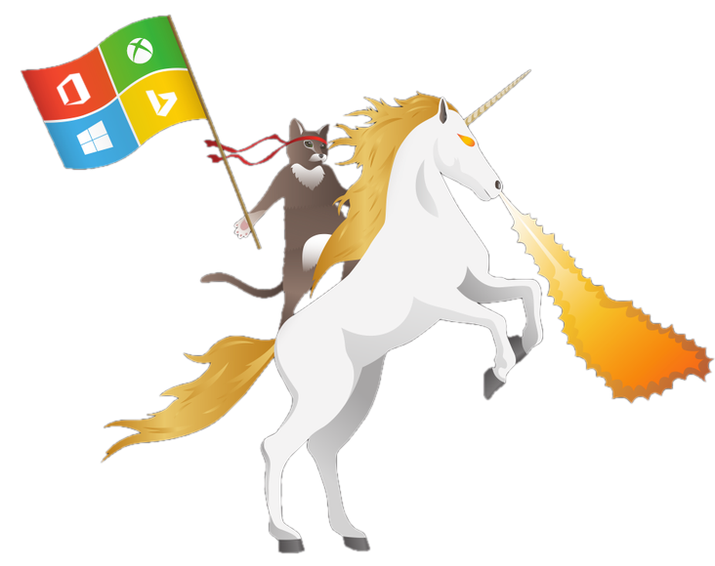
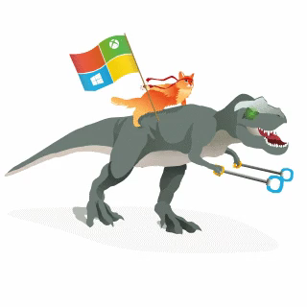
Become a Windows Insider!
https://insider.windows.com/

Slide 4
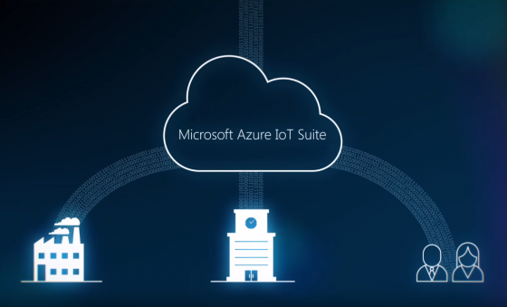
A fully managed service that enables reliable and secure bidirectional communications between millions of IoT devices and a solution back end.

Slide 5

Device Challenges
Are often embedded systems with no human operator.
Can be in remote locations, where physical access is very expensive.
May only be reachable through the solution back end.
May have limited power and processing resources.
May have intermittent, slow, or expensive network connectivity.
May need to use proprietary, custom, or industry-specific application protocols.
Can be created using a large set of popular hardware and software platforms.

Slide 6
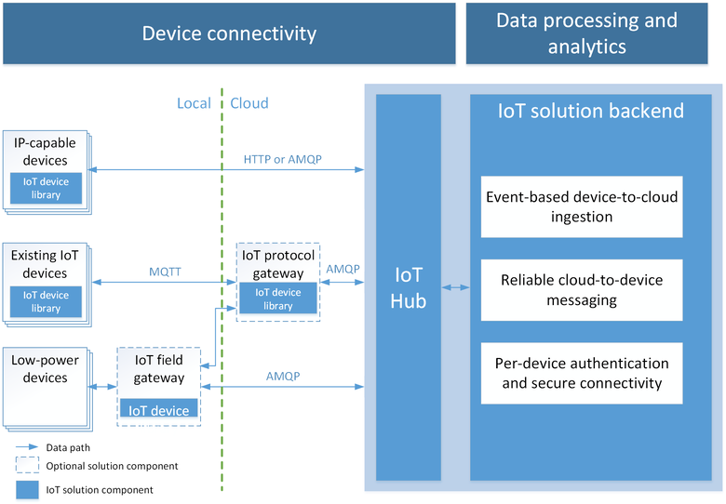
What is this hub thing?

Slide 7

So how do these things connect again?
AMQP
MQTT
HTTPS
What is this “Telemetry” thing people are talking about?

Slide 8
But are these things secure?

Slide 9
This looks familiar?
IoT Hub
Event Hub
Provides device-to-cloud event ingress and cloud-to-device messaging.
Provides per-device identity and revocable access control.
Provides device SDKs for a large variety of platforms and languages.
Only provides event ingress.
Required to implement a custom solution to support per-device credentials and anti-spoofing measures.
Is supported on .NET, and C. Not UWP support.

Slide 10
Can I use just any old OS?
Linux: Debian, Fedora, Raspbian, Ubuntu, Yocto
Windows: Desktop, IoT Core, Server, Embedded Compact
mbed OS
TI-RTOS

Slide 11
Can I use just any old language on any device?
Beaglebone
Minnowboard Max
Intel Edison
Raspberry Pi 2
Freescale FRDM K64
TI CC3200
Arrow DragonBoard
Your Computer
C#
Java
Javascript
C <- The sexy isn’t dead yet!
https://azure.microsoft.com/en-us/develop/iot/get-started/

Slide 12
Is this gonna bankrupt me?

Slide 13
How much can I really use?

Slide 14
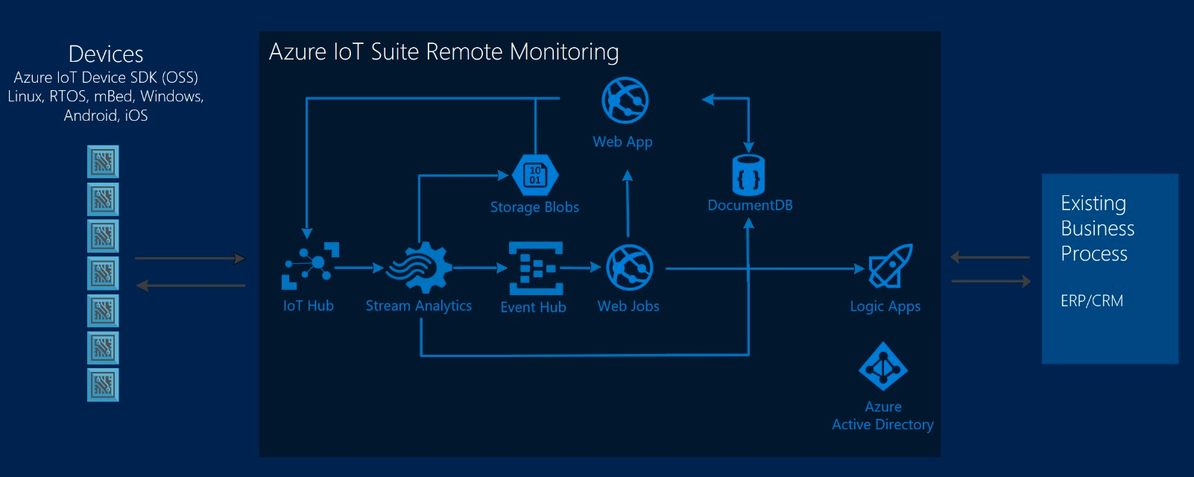
So what can I do with stuff?

Slide 15
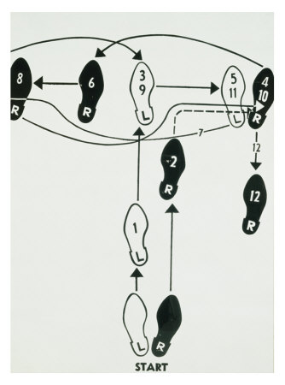
Basic Steps
Get an Azure account
Setup an IoT hub
Grab some credentials
Code up a sender, a receiver, and a device if you have it.

Slide 16
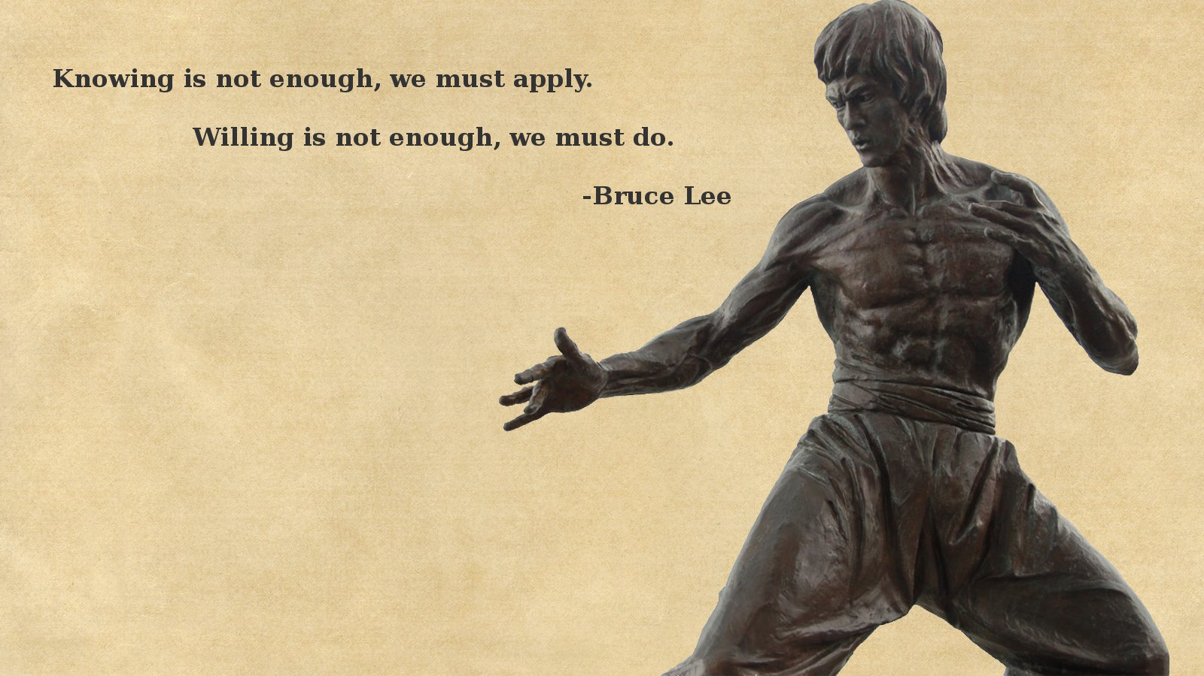
Enough! Show the goods!

Slide 17
Links
Main site: https://azure.microsoft.com/en-us/services/iot-hub/
Dev Guide: https://azure.microsoft.com/en-us/documentation/articles/iot-hub-devguide/
Azure Fridays: https://azure.microsoft.com/en-us/documentation/videos/azure-friday/
Elio Damaggio’s video: https://azure.microsoft.com/en-us/documentation/videos/azurecon-2015-overview-of-azure-iot-hub/
Oliver Bloch’s AzureCon video: https://azure.microsoft.com/en-us/documentation/videos/azurecon-2015-connect-your-iot-devices-with-azure-iot-client-libraries/
Fez Hat: https://www.ghielectronics.com/catalog/product/500

Slide 18
Device Explorer: https://github.com/Azure/azure-iot-sdks/blob/master/tools/DeviceExplorer/doc/how_to_use_device_explorer.md
My examples and slides: https://github.com/pulcher/AzurePlay

Slide 19
